Slide 2
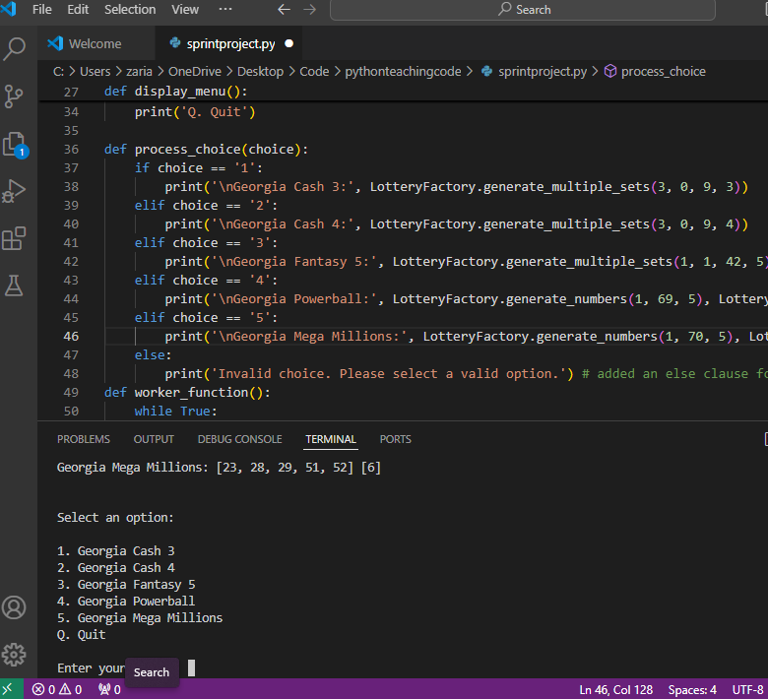
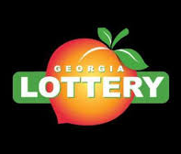
Lottery Number Generator
Dream Big, Play Smart: Generate Your Winning Numbers Now!

